Slide 1
SD iCARD
Presented by Team A³

Slide 2
Why we have chosen this topic?
Social distancing is a concept which came up during the COVID period. Since COVID has not been eradicated fully social distancing needs to be maintained still so that we don't face the consequences we have suffered before. But in this fast world people have nearly forgotten about social distancing.
So here we introduce the wearable SD iCard or the Social Distancing identification Card which will help people to maintain the social distancing among them. We have used PIR sensor in this device which are generally used in thermal sensing applications, such as security and motion detection in front of it and then alarming the user to maintain a safe distance. The system provides an automated social distancing system.

Slide 3
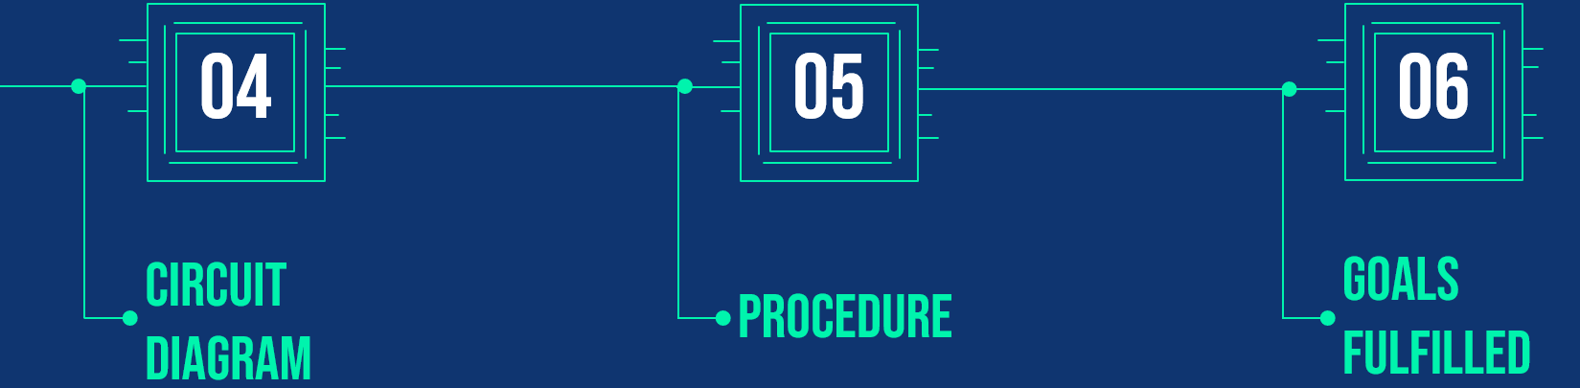
TABLE OF CONTENTS
01
02
03
ABOUT THE PROJECT
MAJOR REQUIREMENTS
THEORY

Slide 4
ABOUT THE PROJECT
In Today’s world , social distancing has become a norm in any social interaction we have due to the increasing threat of the spread of Covid-19. There are many innovations that have been created to help combat and reduce the spread of the deadly disease, not just with other types of devices but using the power of Arduino as well.
This project created aims to help us to reduce the potential spread of the disease by utilizing an PIR Motion Sensor. The sensor (HC-SR501) detects the motion of human in front of it and works on the basis of infrared sensor module. If anybody comes within 1.5m of the sensor, a buzzer sounds, and a LED lights up, therefore signaling the person that someone is within the range of social distancing.
This Arduino device can be used in real-life situations. For example, if you're in a queue at a coffee shop or at a train station. Overall, as individuals, we need to start adapting social distancing more and this is exactly what this device promotes through its visual and audio aids via the buzzer and LED.

Slide 5

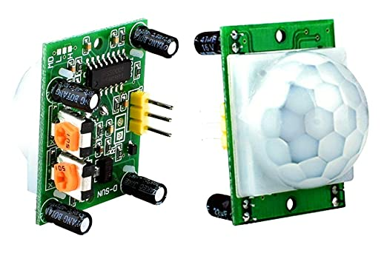
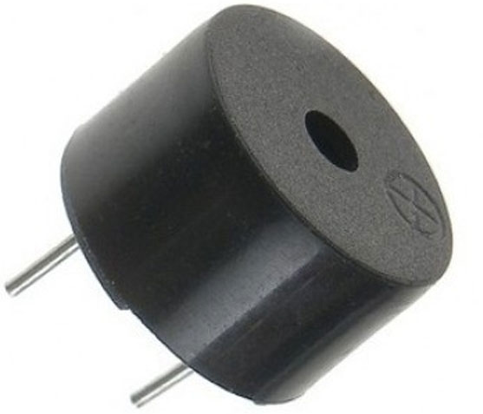
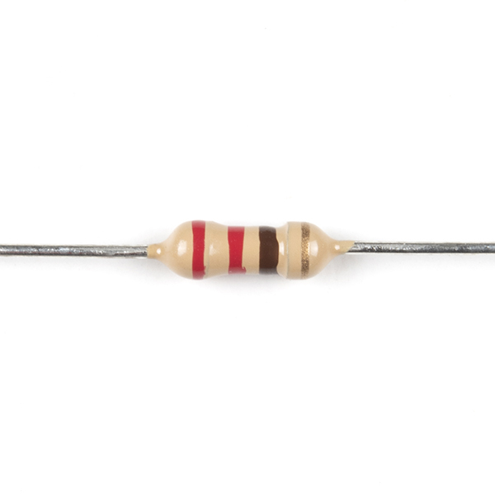
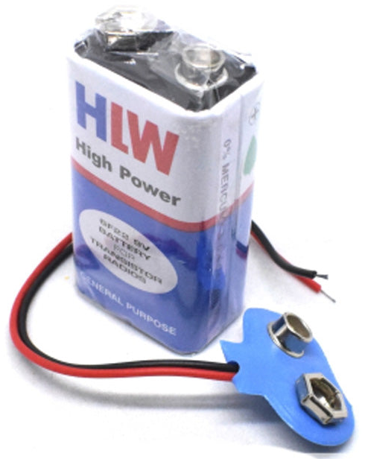
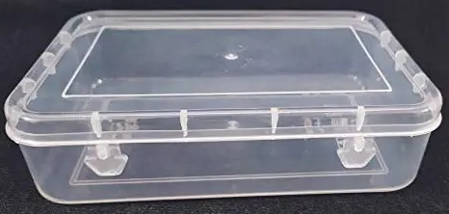
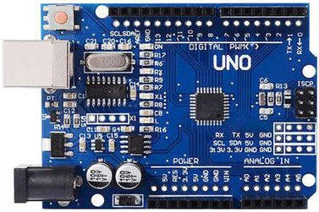
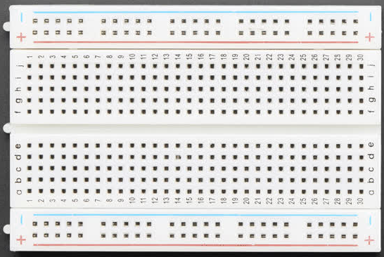
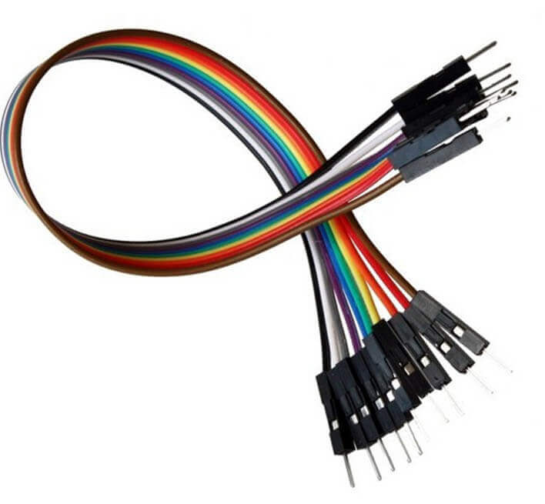
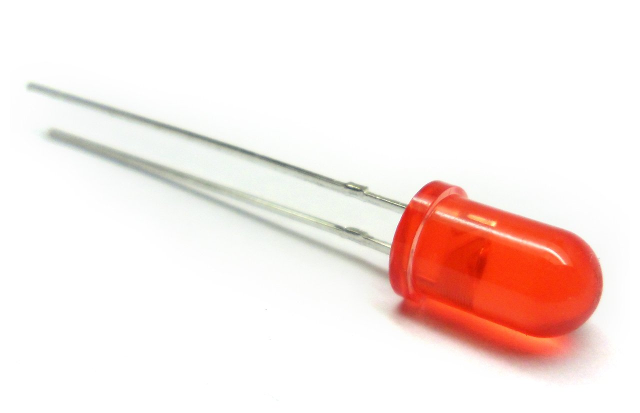
MAJOR REQUIREMENTS
Battery (12V) & Cap
Box
Buzzer
PIR Sensor
HC-SR501
Resistor
220 ohm
Breadboard
Arduino UNO
Red Led (5mm)
Jumper Wires

Slide 6
THEORY
Arduino UNO : The Arduino UNO is a microcontroller board based chip on the ATmega328. It has sets of digital and analog input/output pins which are programmable with Arduino IDE using USB cable. Arduino Uno can detect the surroundings from the input.
HC-SR501 Sensor : HC-SR501 is a Passive Infrared (PIR) motion detector sensor. It is used for detection of moving objects, particularly for the human. Such, device consists of such component and integrated as a component of a system that automatically performs a task or alerts a user motion in that area. They form a vital component of security motion in that area , energy efficiency, automatic light control and other useful systems. Its module also contain time delay adjustment and trigger selection which allow for fine tuning with your application.
Buzzer : The buzzer is a sounding device that can convert audio signals into sound signals. It is usually powered by DC voltage. It is widely used in alarms, computers and other electronic products as sound devices. According to different designs and uses, the buzzer can emit various sounds such as music, siren, alarm and electric bell.
LED : LED (Light Emitting Diode) is a semiconductor device that emits light when an electric current flows through it. When current passes through an LED, the electrons recombine with holes emitting light in the process. LEDs allow the current to flow in the forward direction and blocks the current in the reverse direction.

Slide 7
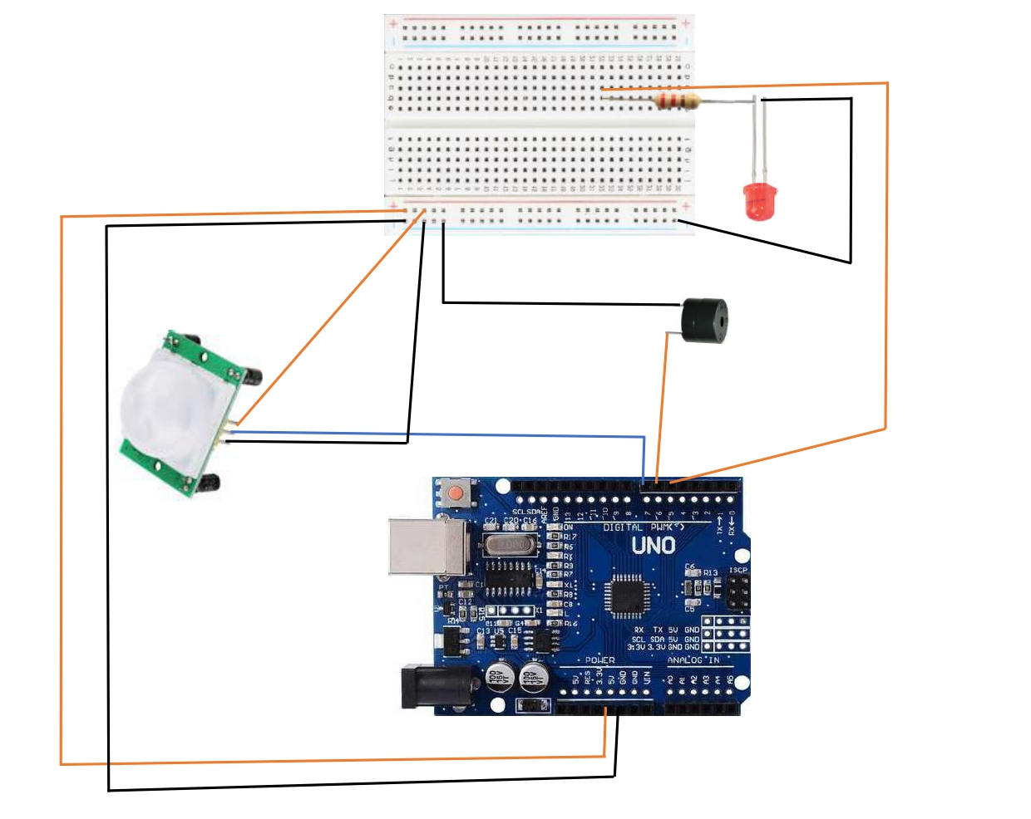
CIRCUIT DIAGRAM

Slide 8
PROCEDURE
First , connect the GND and 5V of Arduino UNO with the GND and Vcc of small breadboard using jumper wires respectively.
Then , connect the Vcc , GND and Signal of HC-SR501 PIR sensor with the Vcc & GND of breadboard and pin no. 7 of Arduino respectively using wires.
Put the Buzzer in the breadboard and connect the –ve pin with the GND of breadboard and +ve pin with pin no. 6 of Arduino.
Take a Led(5mm) and connect a resistor of 220 ohm to the +ve pin and further connect it with pin no. 5 of Arduino.Ground the –ve pin of led to the breadboard.
After setting up the circuit , open the Arduino IDE Application in laptop/desktop and write the desired code for the circuit and run it.
Then connect the Arduino with laptop/desktop using USB cable.
After saving the code , select Arduino UNO and port COM4 in Tools section and finally upload the code to board.
Lastly , check the device after connecting the battery with the GND and Vin pin of the Arduino.

Slide 9
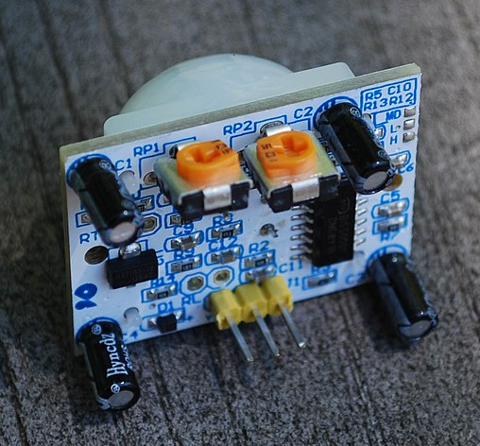
GOALS FULFILLED
Through this project we goal in making social distancing a part of everyone's life so that we are saved from the consequences we had faced due to COVID. The main contribution of the project is that it efficiently and cost-effectively guarantees safe social distancing between people. This Icard has been especially designed for working people and students for their safety from COVID. The developed SD iCard has been validated through several experiments, and achieved reasonable accuracy and user acceptability. This project can be upgraded in the future by using nano Arduino and smaller breadboard which can reduce its cost effectively. We aim to employ wireless sensor networks to guarantee high localization accuracy, minimum cost, and low power consumption for future works.

Slide 10

THANK YOU

